Slide 1


Lecture #0
CSE332
INDUSTRY ETHICS AND LEGAL ISSUES

Slide 2
Course Overview
CSE510, Lovely Professional University, Phagwara
L T P : Credits:2
Text Book:
1. ETHICS IN INFORMATION TECHNOLOGY by GEORGE W REYNOLDS, CENGAGE LEARNING
Reference books:
“INTELLECTUAL PROPERTY RIGHTS-LAW AND PRACTICE” by ICSI House, 22, Institutional Area, Lodi Road, New Delhi 110 003
2 | 0 | 0

Slide 3
Marks Breakup:
CA1 will be subjective, CA2 will be MCQ and CA3 will be based on IPR Submission.
Out of CA1 and CA2, best should be considered.
CA3 is mandatory.
CA1 (Class Test) will be held on 5th Week
CA2 (Class Test) Will be held on 9th Week
CA3 (Presentation) Will be held on 12th Week
Activity | Marks
Attendance | 5
Continuous Assessment (CA)* | 25
Mid-Term Examination (MTE) | 20
End-Term Examination (ETE) | 50
Total | 100
CSE332, Lovely Professional University

Slide 4

What is an Industry ethics and legal issues

Slide 5
What is an Industry?
Any type of Economic Activity producing products or
Services.
Economic activity is the activity of making, providing, purchasing, or selling goods or services.
It is part of a chain –from raw materials to finished product, finished product to service sector, and service sector to research and development.
Eg:-Google Assistant(product) launched by Google

Slide 6
ETHICS
Again

Slide 7
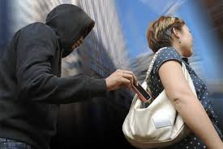
ETHIC! a big question mark

Slide 8

SECOND SITUATION

Slide 9
Ethics
Computer ethics is a system of moral standards or values used as a guideline for computer users.
Eg:- Google has released what is effectively a rulebook for how the company will apply AI technology
The seven principles include making sure that AI is applied to applications that are socially beneficial, safe and won't create unfair bias.

Slide 10
Legal Issues
A legal issue can be any question of law that arises from a particular set of facts.
To prevent the misuse of computers.
Eg:- Copying and Legal Issues
make sure your research and development teams thoroughly research the patents and copyrights of your current product, to avoid a messy legal battle should you step on a competitor's toes.

Slide 11
Learning Outcomes
By the end of this course students will be able to:
To understand ethical environment of work.
Understand the concept of intellectual properties.
Describe the various types of funding and schemes for start up business in IT sector.
Comply with various cyber laws and related semantics for deploying security mechanisms in IT industry.
Understand various types of legal, ethical and professional issues in Information Security.
Understand about the latest trends and current issues in information technology.

Slide 12
Learning Outcomes
Reflectively judge the morality of behaviours involving the use of computers
Defend or attack a wide range of moral and/or legal standpoints involving the use of computers.
Recognize and act upon legal issues and constraints in computing

Slide 13









6
UNITS
Notes:
Along the way we’ve discovered…

Slide 14
UNIT 1
Ethics
What is an ethical work environment.
Ethical Decision Making.
Ethics in Information Technology.
Ethical behavior of IT professional.
Ethical Practices of IT Users.

Slide 15
UNIT 2
Intellectual Properties
What is Intellectual Properties ?
What is the need?
How we can do it
Difference between patent, copyright, trademark, trade secret and geographical indicator.
Importance of Patent information in Business Development.

Slide 16
UNIT 3
Government Funding and schemes for Startup
What are Startups.
Benefit of startups.
Startup India
NASSCOM
Software Technology Parks
Laws for startup
Notes:
NASSCOM, a not-for-profit industry association, is the apex body for the 154 billion dollar Indian IT BPM industry.
Software Technology Parks of India is a society established in 1991 by the Indian Ministry of electronics and Information Technology with the objective of encouraging, promoting and boosting the export of software from India

Slide 17
UNIT 4
Startup in IT
Idea
Planning
General company Description,
Marketing plan,
Operational plan, Management
Various examples of successful start-ups

Slide 18


Slide 19
UNIT 5
Companies
What are the companies act
What is NASSCOM,
What is STPI
And Recent technology advancement,

Slide 20
UNIT 6
Legal, Ethical and Professional issues in Information Security:
What is Cyber Crime?
Law and ethics in information security
Policy versus Law
Cyber law of India
Need for cyber law in India

Slide 21

Intellectual Properties

Slide 22
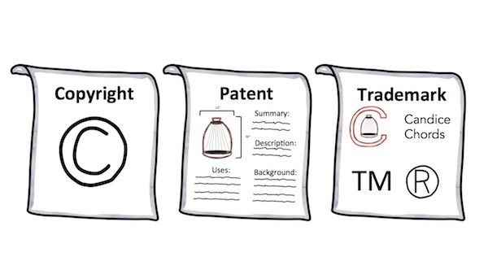
Types of IP

Slide 23
ANNEXURE 1
INVENTION DISCLOSURE FORM

Slide 24
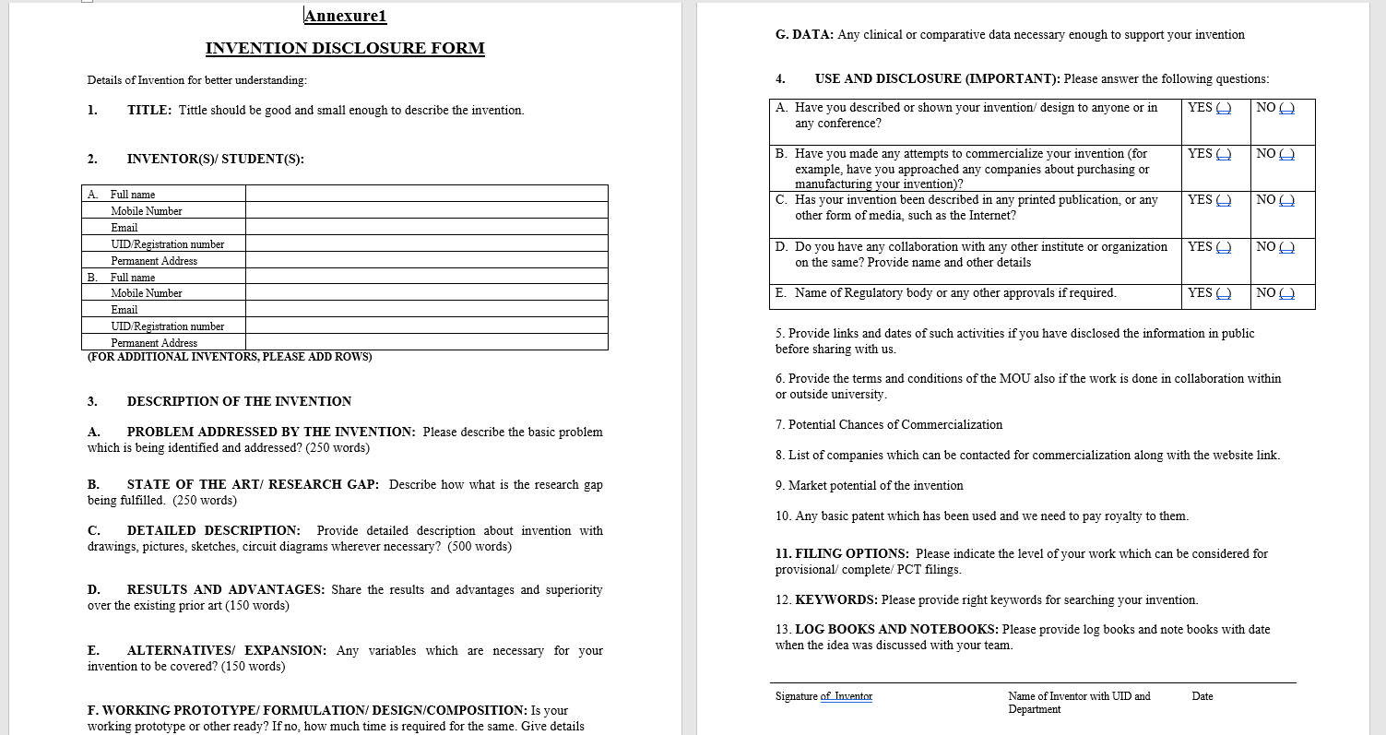
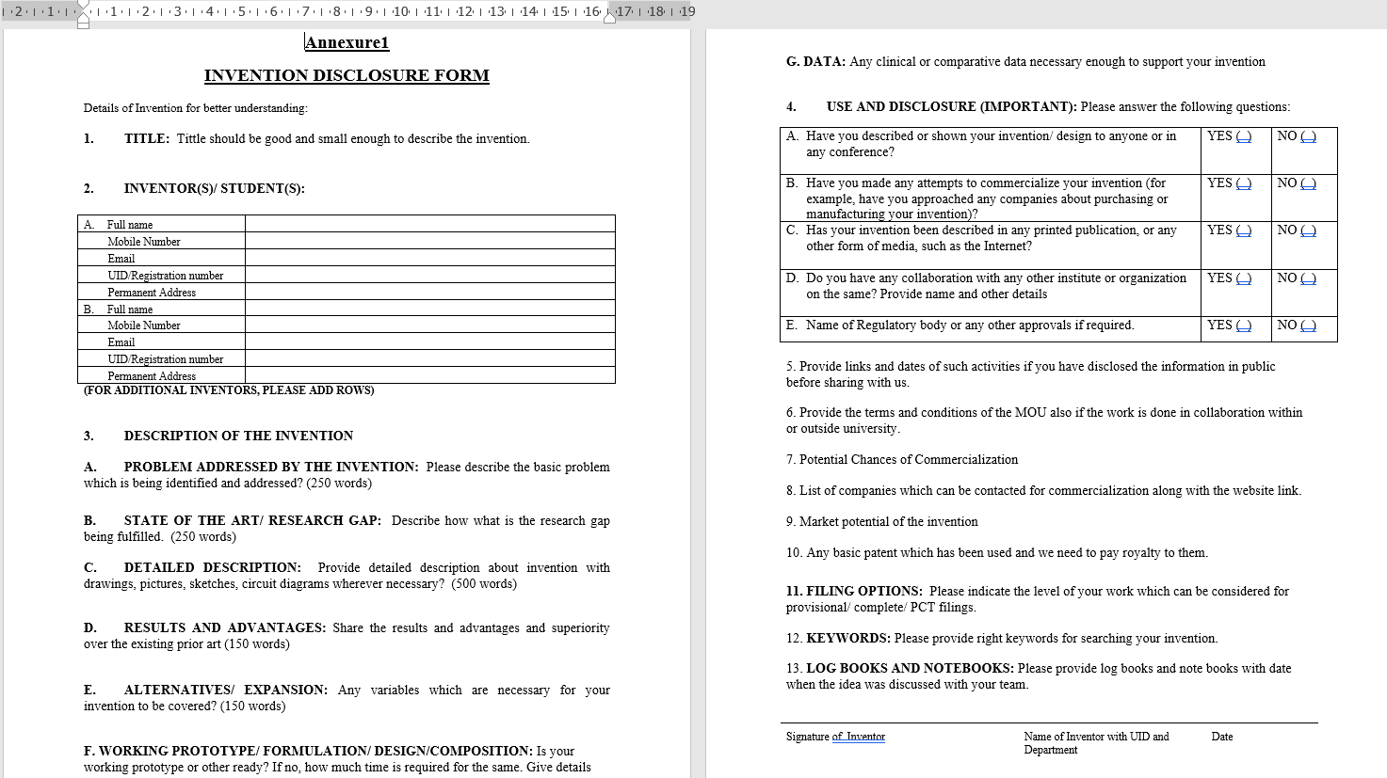

Slide 25

CSE510, Lovely Professional University, Phagwara
Thank You !!!

Slide 26
CSE510, Lovely Professional University, Phagwara
Next Class:
Ethics
ETHICS IN THE BUSINESS WORLD
What is an ethical work environment

